Slide 1
Python Advanced Python Scripting
Module - 2
Presentation By
Mohammed Tahir Mirji
MTech CS

Slide 2
CONTENTS
Write & run scripts locally
Work with raw input from users
Read and write files
Handle File error
Import Local scripts
Reading and loading text, csv data files using python
Using Modules from standard library & third party
Debugging python code
Understanding packaging of python code to EXE
Assignments
Code Examples Github Link

Slide 3
Write & run scripts locally
The most basic and easy way to run a Python script is by using the python command. You need to open a command line and type the word python followed by the path to your script file,
Ex: python first_script.py

Slide 4
Work with raw input from users
Python provides us with two inbuilt functions to read the input from the keyboard.
input()
raw_input() functions in Python

Slide 5
Work with raw input from users
input() function
Python input() function is used to take the values from the user. This function is called to tell the program to stop and wait for the user to input the values. It is a built-in function.
In Python 3.x, the input function explicitly converts the input you give to type string. But Python 2.x input function takes the value and type of the input you enter as it is without modifying the type.

Slide 6
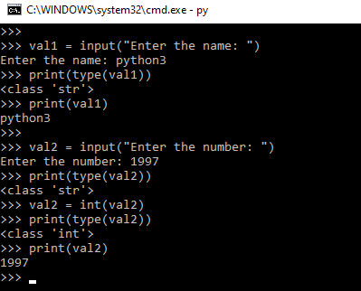
Work with raw input from users
val1 = input("Enter the name: ")
# print the type of input value
print(type(val1))
print(val1)
val2 = input("Enter the number: ")
print(type(val2))
val2 = int(val2)
print(type(val2))
print(val2)

Slide 7
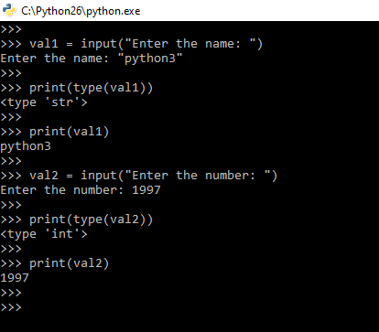
Work with raw input from users
val1 = input("Enter the name: ")
print(type(val1))
print(val1)
val2 = input("Enter the number: ")
print(type(val2))
print(val2)

Slide 8
Work with raw input from users
raw_input() function
Python raw_input function is used to get the values from the user. We call this function to tell the program to stop and wait for the user to input the values. It is a built-in function.

Slide 9
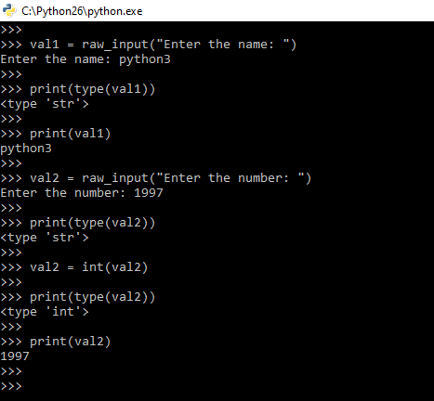
Work with raw input from users
# Python program to demonstrate
# input() function in Python2.x
val1 = raw_input("Enter the name: ")
print(type(val1))
print(val1)
val2 = raw_input("Enter the number: ")
print(type(val2))
val2 = int(val2)
print(type(val2))
print(val2)

Slide 10
Work with raw input from users
SN | input() | raw_input()
1. | input() function take the user input. | raw_input() function takes the input from the user.
2. | Its syntax is -: input(prompt) | Its syntax is -: raw_input(input)
3. | It takes only one parameter that is prompt. | It takes only one parameter that is the input.
4. | It return the input that it takes. | Its return type is of string.
5. | It converts the input into a string by removing the trailing newline | It is only introduced in python 2.0 version

Slide 11
Read and write files
Python provides inbuilt functions for creating, writing, and reading files. There are two types of files that can be handled in python, normal text files and binary files (written in binary language, 0s, and 1s)
Text files: In this type of file, Each line of text is terminated with a special character called EOL (End of Line), which is the new line character (‘\n’) in python by default.
Binary files: In this type of file, there is no terminator for a line, and the data is stored after converting it into machine-understandable binary language.

Slide 12
Read and write files - File Access Modes
Access modes govern the type of operations possible in the opened file. It refers to how the file will be used once its opened. These modes also define the location of the File Handle in the file. File handle is like a cursor, which defines from where the data has to be read or written in the file. There are 6 access modes in python.

Slide 13
Read and write files - File Access Modes
Read Only (‘r’) : Open text file for reading. The handle is positioned at the beginning of the file. If the file does not exists, raises the I/O error. This is also the default mode in which a file is opened.
Read and Write (‘r+’): Open the file for reading and writing. The handle is positioned at the beginning of the file. Raises I/O error if the file does not exist.

Slide 14
Read and write files - File Access Modes
Write Only (‘w’) : Open the file for writing. For the existing files, the data is truncated and over-written. The handle is positioned at the beginning of the file. Creates the file if the file does not exist.
Write and Read (‘w+’) : Open the file for reading and writing. For an existing file, data is truncated and over-written. The handle is positioned at the beginning of the file.

Slide 15
Read and write files - File Access Modes
Append Only (‘a’): Open the file for writing. The file is created if it does not exist. The handle is positioned at the end of the file. The data being written will be inserted at the end, after the existing data.
Append and Read (‘a+’) : Open the file for reading and writing. The file is created if it does not exist. The handle is positioned at the end of the file. The data being written will be inserted at the end, after the existing data.

Slide 16
Read and write files - Opening a File
It is done using the open() function. No module is required to be imported for this function.
File_object = open(r"File_Name","Access_Mode")
The file should exist in the same directory as the python program file else, the full address of the file should be written in place of the filename.
The r makes the string raw, that is, it tells that the string is without any special characters.
Note: The r is placed before the filename to prevent the characters in the filename string to be treated as special characters.

Slide 17
Read and write files - Opening a File
file1 is created as an object for MyFile1 and file2 as object for MyFile2
# Open function to open the file "MyFile1.txt"
# (same directory) in append mode and
file1 = open("MyFile.txt","a")
# store its reference in the variable file1
# and "MyFile2.txt" in D:\Text in file2
file2 = open(r"D:\Text\MyFile2.txt","w+")

Slide 18
Read and write files - closing a File
close() function closes the file and frees the memory space acquired by that file. It is used at the time when the file is no longer needed or if it is to be opened in a different file mode.
File_object.close()
# Opening and Closing a file "MyFile.txt"
# for object name file1.
file1 = open("MyFile.txt","a")
file1.close()

Slide 19
Read and write files - Writing to a file
There are two ways to write in a file.
write() : Inserts the string str1 in a single line in the text file.
File_object.write(str1)
writelines() : For a list of string elements, each string is inserted in the text file.Used to insert multiple strings at a single time.
File_object.writelines(L) for L = [str1, str2, str3]

Slide 20
Read and write files - Reading from a file
There are three ways to read data from a text file.
read() : Returns the read bytes in form of a string. Reads n bytes, if no n specified, reads the entire file.
File_object.read([n])
readline() : Reads a line of the file and returns in form of a string.For specified n, reads at most n bytes. However, does not reads more than one line, even if n exceeds the length of the line.
File_object.readline([n])

Slide 21
Read and write files - Reading from a file
There are three ways to read data from a text file.
read() : Returns the read bytes in form of a string. Reads n bytes, if no n specified, reads the entire file.
File_object.read([n])
readline() : Reads a line of the file and returns in form of a string.For specified n, reads at most n bytes. However, does not reads more than one line, even if n exceeds the length of the line.
File_object.readline([n])

Slide 22
Read and write files - Reading from a file
readlines() : Reads all the lines and return them as each line a string element in a list.
File_object.readlines()
Note: ‘\n’ is treated as a special character of two bytes
Seek arguments:
0: sets the reference point at the beginning of the file
1: sets the reference point at the current file position
2: sets the reference point at the end of the file

Slide 23
Output Formatting
Formatting output using String modulo operator(%)
The % operator can also be used for string formatting. To this purpose, the modulo operator % is overloaded by the string class to perform string formatting. Therefore, it is often called a string modulo (or sometimes even called modulus) operator.
print(“Value : %2d, Portal : %5.2f" % (1, 05.333))
# print integer value
print("Total students : %3d, Boys : %2d" % (240, 120))
# print octal value
print("%7.3o" % (25))
# print exponential value
print("%10.3E" % (356.08977))

Slide 24
WITH statement in file handling
with statement in Python is used in exception handling to make the code cleaner and much more readable. It simplifies the management of common resources like file streams.
# 1) without using with statement
file = open('file_path', 'w')
file.write('hello world !')
file.close()
with open("file.txt") as file:
data = file.read()

Slide 25
Handle File errors
Error in Python can be of two types i.e. Syntax errors and Exceptions. Errors are the problems in a program due to which the program will stop the execution.
On the other hand, exceptions are raised when some internal events occur which changes the normal flow of the program.
Difference between Syntax Error and Exceptions
Syntax Error: As the name suggests this error is caused by the wrong syntax in the code. It leads to the termination of the program.
Exceptions: Exceptions are raised when the program is syntactically correct, but the code resulted in an error. This error does not stop the execution of the program, however, it changes the normal flow of the program.

Slide 26


Handle File errors
amount = 10000
# check that You are eligible to
if(amount > 2999)
print("You are eligible to purchase")
marks = 10000
# perform division with 0
a = marks / 0
print(a)
In the above example raised the ZeroDivisionError as we are trying to divide a number by 0.

Slide 27
Try and Except Statement – Catching Exceptions
Try and except statements are used to catch and handle exceptions in Python. Statements that can raise exceptions are kept inside the try clause and the statements that handle the exception are written inside except clause.
Ex: Python program to handle simple runtime error
a = [1, 2, 3]
try:
print ("Second element = %d" %(a[1]))
# Throws error since there are only 3 elements in array
print ("Fourth element = %d" %(a[3]))
except:
print ("An error occurred")

Slide 28
Import Local scripts

Slide 29
Reading and loading text, csv data files using python
A CSV (Comma Separated Values) file is a form of plain text document which uses a particular format to organize tabular information. CSV file format is a bounded text document that uses a comma to distinguish the values. Every row in the document is a data log. Each log is composed of one or more fields, divided by commas. It is the most popular file format for importing and exporting spreadsheets and databases.

Slide 30
Reading and loading text, csv data files using python
Reading a CSV File
There are various ways to read a CSV file that uses either the CSV module or the pandas library.
csv Module: The CSV module is one of the modules in Python which provides classes for reading and writing tabular information in CSV file format.
pandas Library: The pandas library is one of the open-source Python libraries that provide high-performance, convenient data structures and data analysis tools and techniques for Python programming.

Slide 31
Reading and loading text, csv data files using python
Reading a CSV File
There are various ways to read a CSV file that uses either the CSV module or the pandas library.
csv Module: The CSV module is one of the modules in Python which provides classes for reading and writing tabular information in CSV file format.
pandas Library: The pandas library is one of the open-source Python libraries that provide high-performance, convenient data structures and data analysis tools and techniques for Python programming.

Slide 32
Reading and loading text, csv data files using python
USing csv.reader():
At first, the CSV file is opened using the open() method in ‘r’ mode(specifies read mode while opening a file) which returns the file object then it is read by using the reader() method of CSV module that returns the reader object that iterates throughout the lines in the specified CSV document.
Note: The ‘with’ keyword is used along with the open() method as it simplifies exception handling and automatically closes the CSV file.

Slide 33
Reading and loading text, csv data files using python
import csv
# opening the CSV file
with open('Giants.csv', mode ='r')as file:
# reading the CSV file
csvFile = csv.reader(file)
# displaying the contents of the CSV file
for lines in csvFile:
print(lines)

Slide 34
Reading and loading text, csv data files using python
Using csv.DictReader() class: It is similar to the previous method, the CSV file is first opened using the open() method then it is read by using the DictReader class of csv module which works like a regular reader but maps the information in the CSV file into a dictionary. The very first line of the file consists of dictionary keys.

Slide 35
Reading and loading text, csv data files using python
Using csv.DictReader() class: It is similar to the previous method, the CSV file is first opened using the open() method then it is read by using the DictReader class of csv module which works like a regular reader but maps the information in the CSV file into a dictionary. The very first line of the file consists of dictionary keys.

Slide 36
Reading and loading text, csv data files using python
import csv
# opening the CSV file
with open('Giants.csv', mode ='r') as file:
# reading the CSV file
csvFile = csv.DictReader(file)
# displaying the contents of the CSV file
for lines in csvFile:
print(lines)

Slide 37
Using Modules from standard library & third party
Normally, a library is a collection of books or is a room or place where many books are stored to be used later. Similarly, in the programming world, a library is a collection of precompiled codes that can be used later on in a program for some specific well-defined operations.
Other than pre-compiled codes, a library may contain documentation, configuration data, message templates, classes, and values, etc.
A Python library is a collection of related modules. It contains bundles of code that can be used repeatedly in different programs. It makes Python Programming simpler and convenient for the programmer. As we don’t need to write the same code again and again for different programs. Python libraries play a very vital role in fields of Machine Learning, Data Science, Data Visualization, etc.

Slide 38
Debugging python code

Slide 39
Understanding packaging of python code to EXE

Slide 40
Assignments

Slide 41
Code for the presentation can be found here
Refer Readme.md of github repository for list of assignments:
https://github.com/tahirmirji/ai_with_python_keonics

Slide 42
Thank You

